Slide 1



CSE363 | Cloud Computing
Intelligent Multi-Model AI Agent for Interactive Language Learning
Presented By:
Aser Mohamed
Mohamed Rady
Mohamed Elsayed
Sherif Farag
Youssef Essam
222102487
222200004
222200002
222100822
222101958
Under the supervision of Prof. Eman Kamel and TA: Eng. Shrouk Shata
Galala University · Faculty of Computer Science and Engineering

Slide 2

Project Overview
Problem Statement
PROJECT CATEGORY
Web Application
Traditional language learning tools often provide static content that fails to adapt to individual needs. Learners lack access to personalized, real-time feedback on grammar, vocabulary, and conversation. Our project solves this by creating an intelligent AI tutor that is always available and adapts to every student's unique learning journey.

Slide 3





Compute Layer: Containerization
Why Docker Containers?
Service
Container
Role
Lightweight: Share host OS kernel, saving RAM (50MB vs 1GB for VMs).
API Backend
ai-backend
FastAPI server, AI agent, OCR, TTS, STT
Frontend
ai-frontend
Next.js web UI
Fast Startup: Services launch in seconds, not minutes.
ChromaDB
chromadb
Vector database for RAG
Portability: Identical behavior from development to cloud.
NGINX
Host-level
Reverse proxy, HTTPS, rate limiting
Orchestration: Manage all 7 services with one command.
Prometheus
ai-prometheus
Metrics collection
Grafana
ai-grafana
Live monitoring dashboard
7 Isolated Services Managed Together
cAdvisor
ai-cadvisor
Container metrics exporter
Virtualization via OS-level Containerization

Slide 4

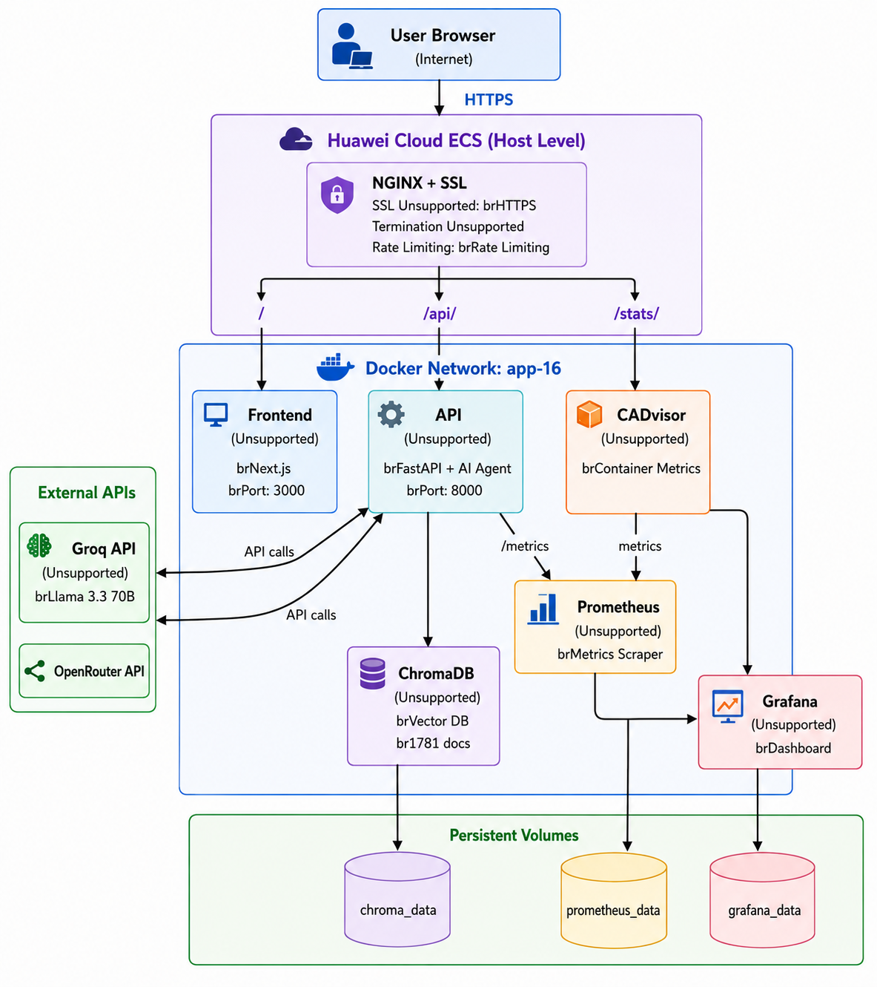




Network Virtualization & Security
Software-Defined Networking
System Architecture Flowchart
Custom Bridge Network: Isolated virtual network (`app-network`) with defined subnet.
DNS Hostnames: Services communicate via names (e.g., `api-backend:8000`) instead of hardcoded IPs.
Security Techniques
Access Control: Only NGINX and Grafana are exposed; Backend and DB remain internal-only.
Rate Limiting: NGINX enforces 30 requests/sec per IP to prevent DDoS and abuse.
SSL/TLS Encryption: End-to-end encryption via Let's Encrypt certificates.

Slide 5



Data Persistence
Concept: Persistent Block Storage
To ensure application data survives service restarts, we use named Docker volumes. These act like cloud block storage, providing durability independent of the container lifecycle.
chroma_data
prometheus_data
grafana_data
Stores 1,781 learning documents for the vector database, ensuring the AI knowledge base is always available.
Preserves time-series metrics history, allowing for continuous and historical monitoring data.
Retains dashboard configurations and data sources, so monitoring setups are never lost.

Slide 6
Resource Management
Service Resource Boundaries
Service
CPU Limit
Memory Limit
CPU Reserved
API Backend
2.0 cores
5 GB
1.0 cores
Frontend UI
1.0 cores
2 GB
0.5 cores
ChromaDB
2.0 cores
5 GB
0.5 cores
NGINX Proxy
0.5 cores
256 MB
-
Prometheus
0.5 cores
512 MB
-
Grafana
0.5 cores
512 MB
-
Explicit boundaries prevent "noisy neighbor" issues where one service starves others. This ensures fair allocation and stable performance across our multi-tenant cloud environment.

Slide 7


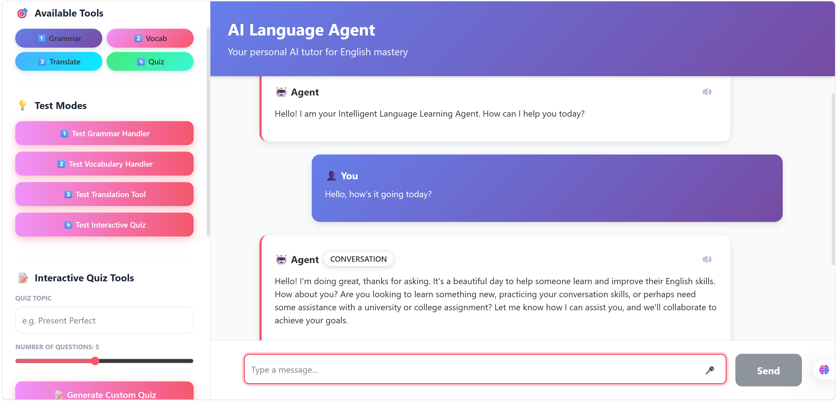


Load Balancing Vs. High Availability
High Availability (Option B)
Live Agent URL:
https://lang-agent-asser.duckdns.org
Restart Policies:
All 7 services use
restart: unless-stopped
ensuring automatic recovery from crashes.
SYSTEM STATUS: HEALTHY & SELF-HEALING
Health Checks: HTTP-based checks verify responsiveness for Backend, Frontend, and ChromaDB every 30 seconds.
Dependency Chain: Services start in order (e.g., Frontend waits for Backend health) to prevent cascading failures.
Fault Tolerance: System detects failures and recovers without manual intervention, ensuring 24/7 availability.
Self-healing mechanisms mirror cloud-native recovery patterns like Kubernetes liveness probes.

Slide 8

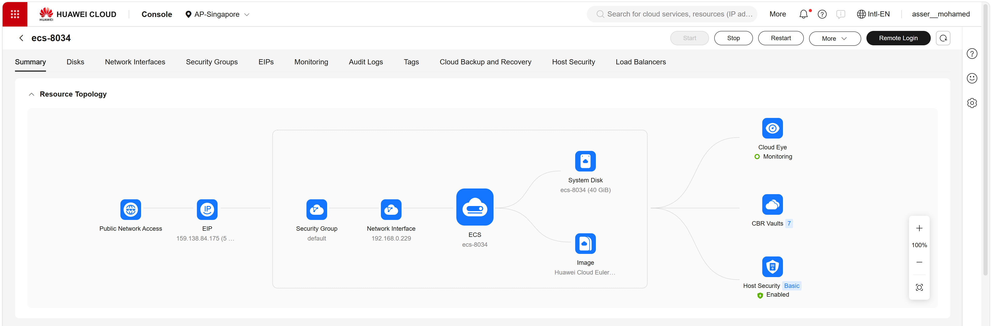


Cloud Deployment: Huawei Cloud
Infrastructure (IaaS)
CLOUD PROVIDER
Huawei Cloud ECS (Elastic Cloud Server)
PUBLIC ACCESS
IP: 159.138.84.175 Domain: lang-agent-asser.duckdns.org
SECURITY & ENCRYPTION
SSL/TLS enabled via Let's Encrypt certificates for secure HTTPS communication.
Deployment Pipeline
Demonstrates real-world cloud engineering practices including public networking, DNS, and container registries.
Automated workflow for production updates:
1. Local Docker Build & Tagging
2. Push to Huawei SWR (Registry)
3. Remote Pull on ECS Instance
4. Container Orchestration via Compose

Slide 9


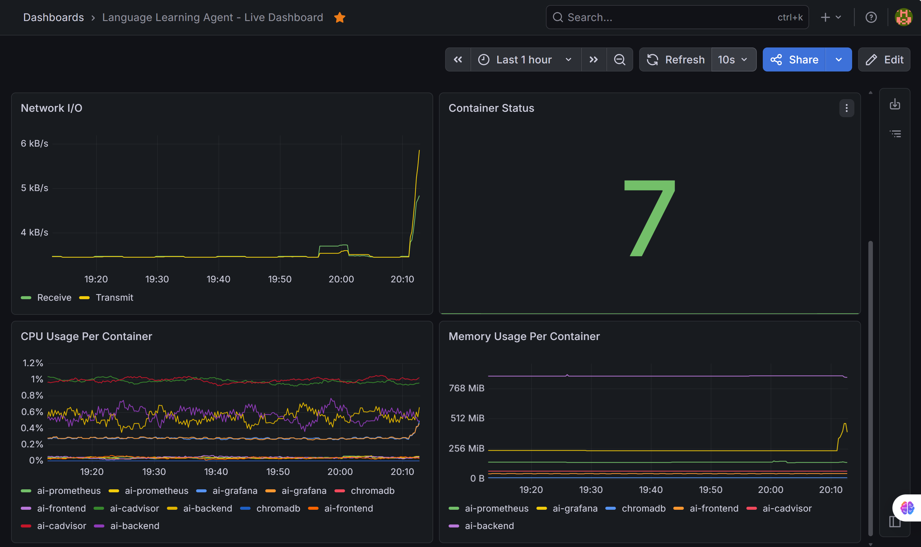


Bonus: Monitoring & Kubernetes
Kubernetes Deployment
Live Dashboard URL:
Orchestration: Full Minikube deployment strategy using 8 specialized manifest files.
https://lang-agent-asser.duckdns.org/stats/
Components: Includes Namespace, Secrets, PVCs, Deployments, StatefulSet, and Ingress configurations.
Live Monitoring Stack
Full Observability: Integrated Grafana + Prometheus + cAdvisor pipeline for real-time metrics.
Metric Panels: 6 live panels visualizing CPU/Memory compliance, Network I/O, and Container Status.
Demonstrates advanced cloud-native scaling and automated resource management beyond basic containerization.

Slide 10


THANK YOU!
Any Questions?

